Slide 1
A brief introduction to graph convolution
Zhizhong LI
Dec 20, 2018

Slide 2
Contents
Introduction
Spectral Graph Convolution
Graph Convolutions

Slide 3
Introduction
Notations
Graph data and tasks
Processing tools

Slide 4
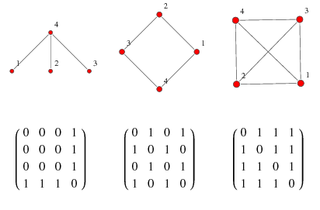
Notation
$G=\left(V, E\right)$
Adjacency matrix $A$

Slide 5
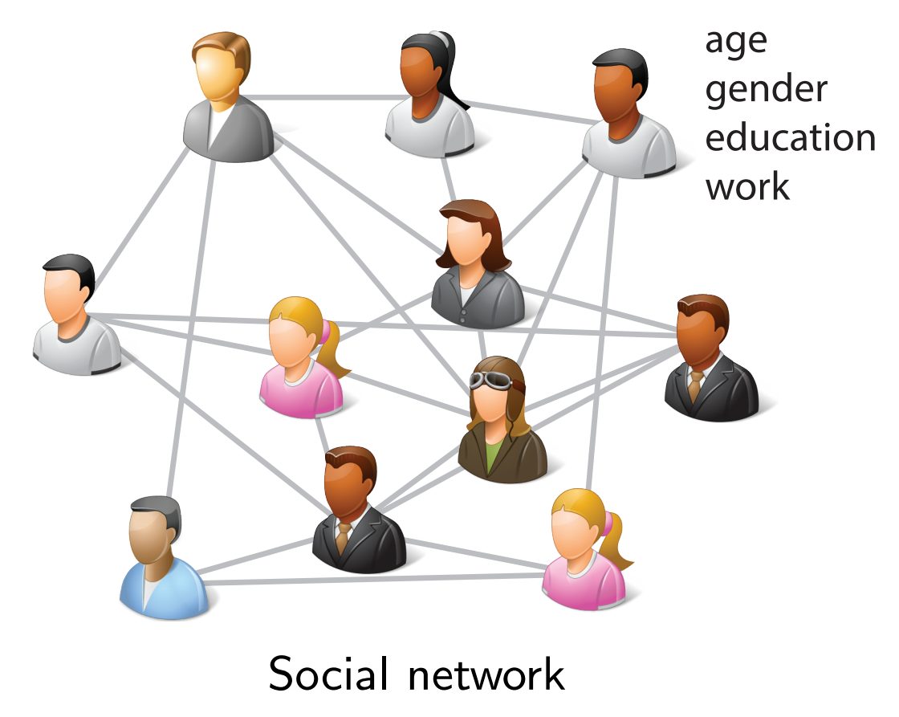
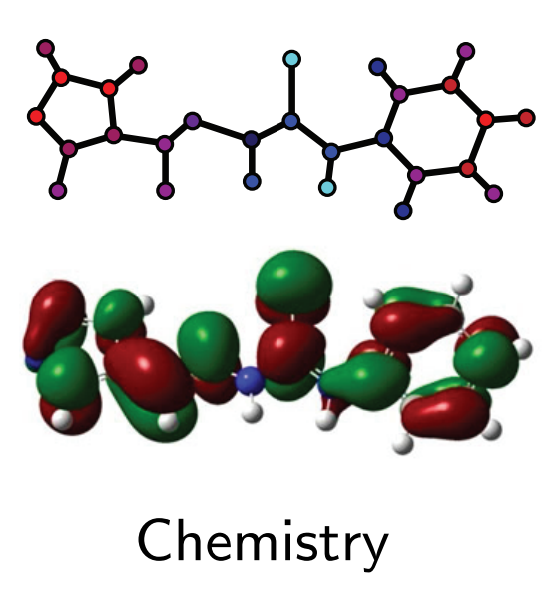
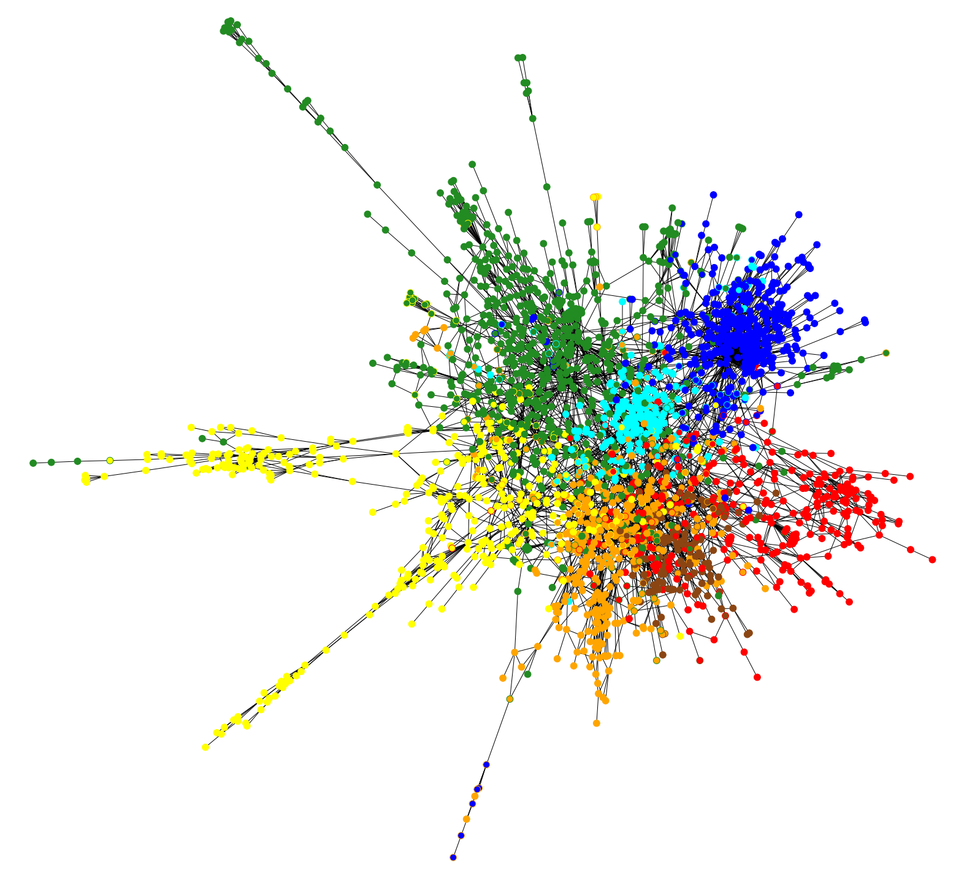
Data on graph
Citation

Slide 6
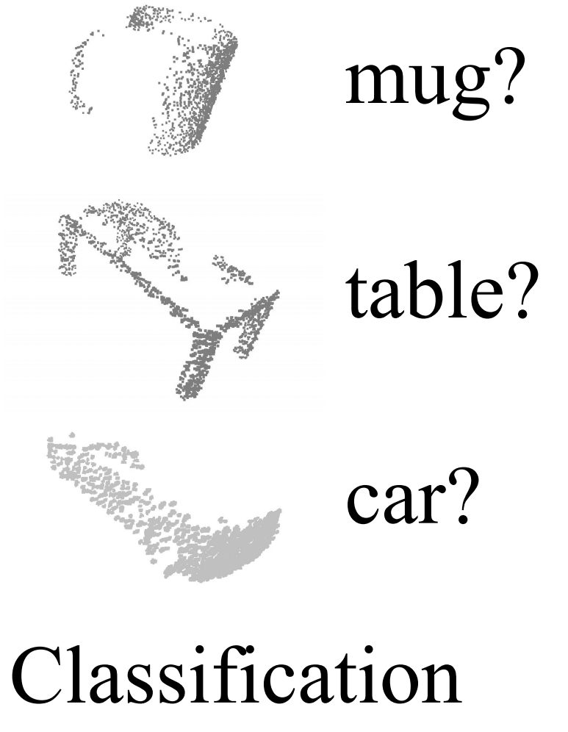
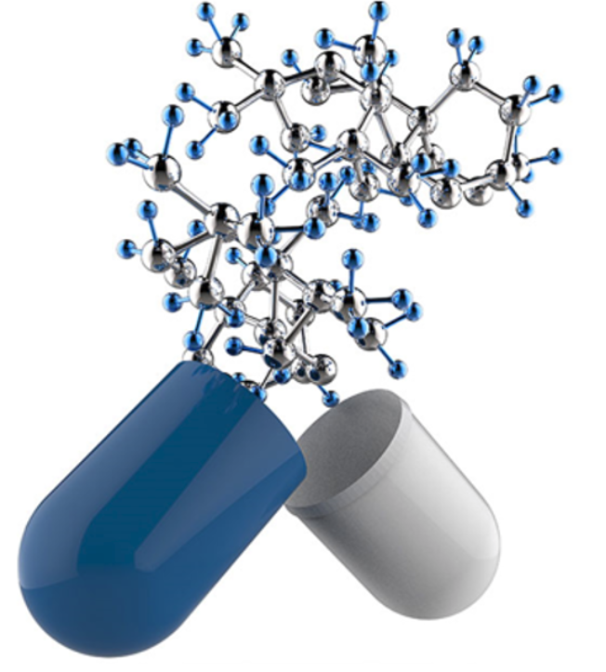
Per-graph prediction
Kick other person
Molecular Activity

Slide 7
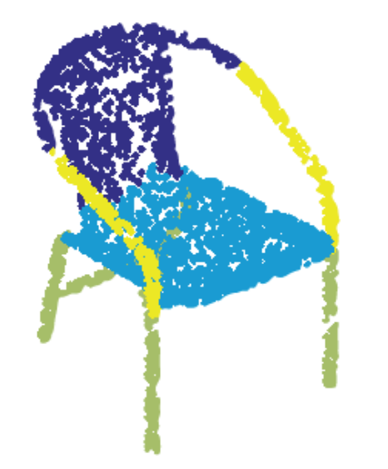
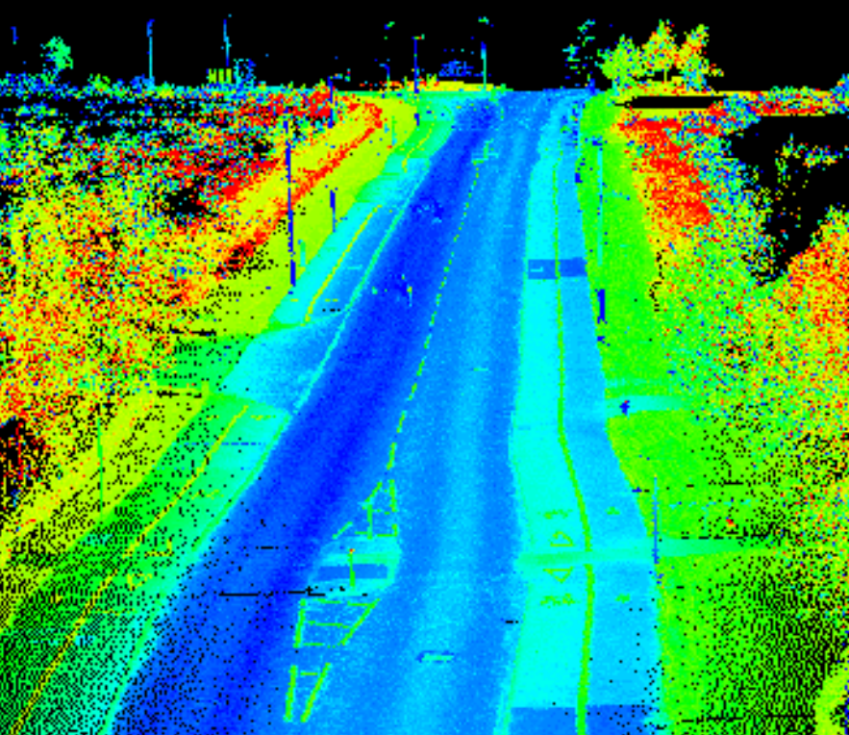
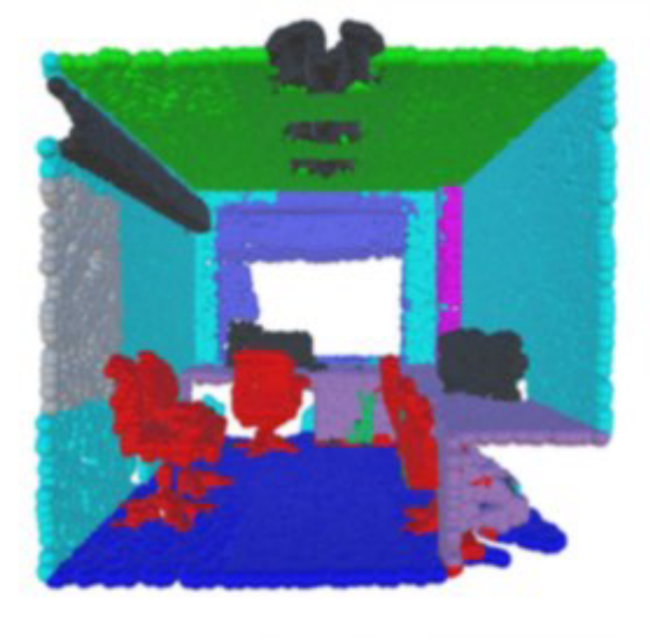
Per-node prediction

Slide 8
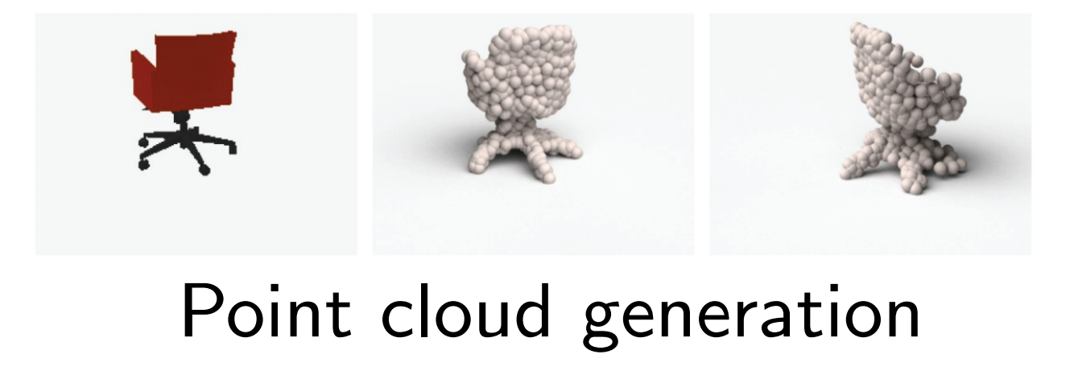
Generation

Slide 9
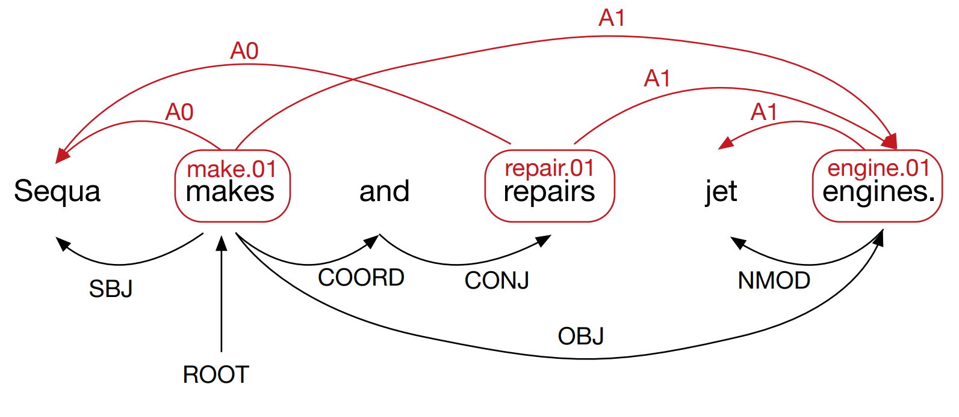
Semantic role labeling
EMNLP 2017, Encoding Sentences with Graph Convolutional Networks for Semantic Role Labeling

Slide 10
Reasoning for segmentation
NIPS 2018, Symbolic Graph Reasoning Meets Convolutions

Slide 11
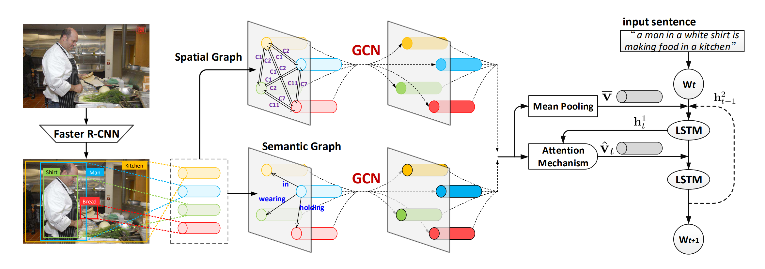
Image captioning
ECCV 2018, Exploring Visual Relationship for Image Captioning

Slide 12
Trending research

Slide 13
Tools
Graph Neural Network (RNN)
Graph Convolution

Slide 14
Graph Neural Network
TNN 2009, The Graph Neural Network Model

Slide 15
Graph Convolution
Spectral
Spatial
ICLR 2014, Spectral Networks and Locally Connected Networks on Graphs
NIPS 2015, Convolutional Networks on Graphs for Learning Molecular Fingerprints

Slide 16
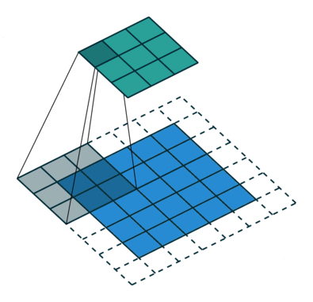
Convolution
Locality
Translation
Hierarchy (strided conv/pooling)
https://github.com/vdumoulin/conv_arithmetic

Slide 17
Spectral Graph Convolution

Slide 18
Convolution theorem
The Fourier transform of a convolution of two signals is the pointwise product of their Fourier transforms.

Slide 19
Fourier basis
Since Fourier arrived at his basis by attempting to solve the heat equation, the natural generalization is to use the eigen-bases of the Laplace-Beltrami operator as a basis.

Slide 20
Combinatorial Graph Laplacian
Kirchhoff operator: $𝒦=ℛ^{−1}−𝒜$, where $ℛ$ is diagonal matrix of $1/d_{i}$
Symmetric, constant zero row sum, eigenvalue range $\left[0, 2d_{max}\right]$
Normalized graph Laplacian $𝒢=I−Q$, where $Q_{ij}= 𝒜_{ij}/\sqrt{d_{i}d_{j}}$
Symmetric, smallest eigenvalue 0 with multiplicity 1
Normalized Tutte Laplacian $𝒯=I − ℛ𝒜$
Not symmetric, has constant zero row sum, eigenvalues are all real and range in $\left[0, 2\right]$
2004, Discrete Combinatorial Laplacian Operators for Digital Geometry Processing

Slide 21
Derive Graph Laplacian
Choose an orientation on the edges, and define the operator $D:l^{2}V→l^{2}E$ as
$Df\left(e\right)=f\left(e^{+}\right)−f(e^{−})$
We think $D$ as a discrete differential operator, then $L=D^{∗}D$, where $D^{∗}$ is the adjoint of $D$.
$Lf\left(v\right)=\deg\left(v\right)f\left(v\right)−\sum_{u:u∼v}{f\left(u\right)}$

Slide 22
Laplacian eigenbases

Slide 23
Spectral convolution

Slide 24
Matrix form
Learnable parameters

Slide 25
Drawback
Not local
Difficult to design good coarsening
Cannot generalize to different graph structures

Slide 26
Convolution via Laplace Spectrum
And use naïve multiscale clustering
ICLR 2014, Spectral Networks and Locally Connected Networks on Graphs

Slide 27
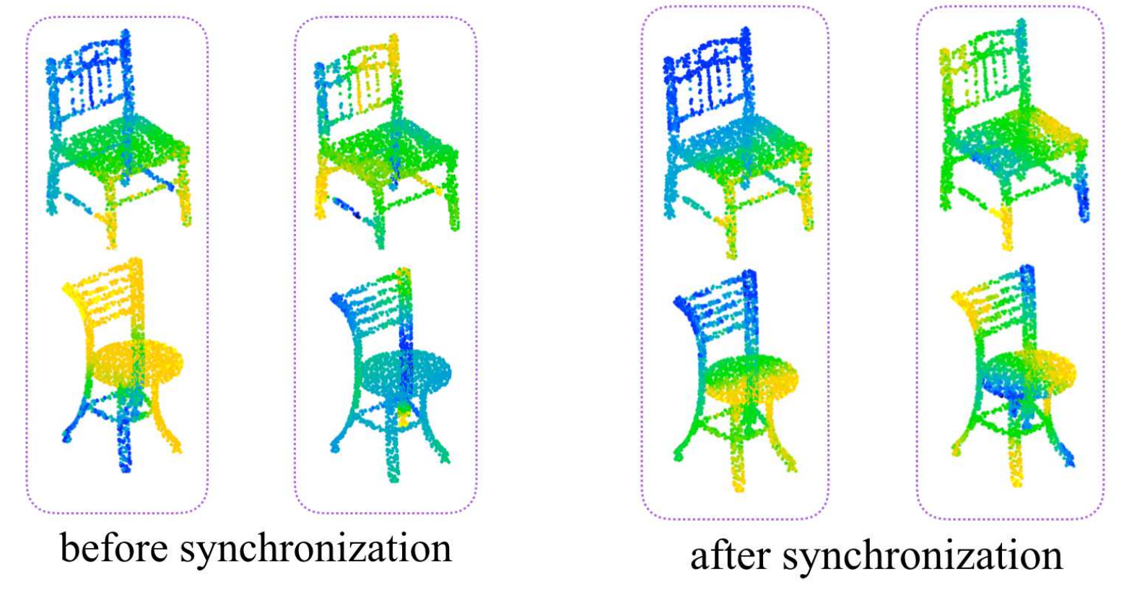
Sync-Spec-CNN
Not localized spectral graph conv
Learn a network for the spectral alignment of each shape
CVPR 2017, SyncSpecCNN Synchronized Spectral CNN for 3D Shape Segmentation

Slide 28
Localized Spectral graph conv
Use polynomials of eigenvalue and learn coefficients
Localized
NIPS 2016, Convolutional Neural Networks on Graphs with Fast Localized Spectral Filtering

Slide 29
Fast pooling
Building a balanced binary tree
NIPS 2016, Convolutional Neural Networks on Graphs with Fast Localized Spectral Filtering

Slide 30
Diffusion-Convolution
Let $P^{∗}$ be an $N×H×N$ tensor containing the power series of the transition matrix $P$.
For node $i$, hop $j$, feature $k$
$$Z_{ijk}=f\left(W_{jk}⋅\sum_{l=1}^{N}{P_{ijl}^{∗}X_{lk}}\right)$$
Spatial conv, share weights for different locations of same or different graphs.
NIPS 2016, Diffusion-Convolutional Neural Networks

Slide 31
Spatial Convolution

Slide 32
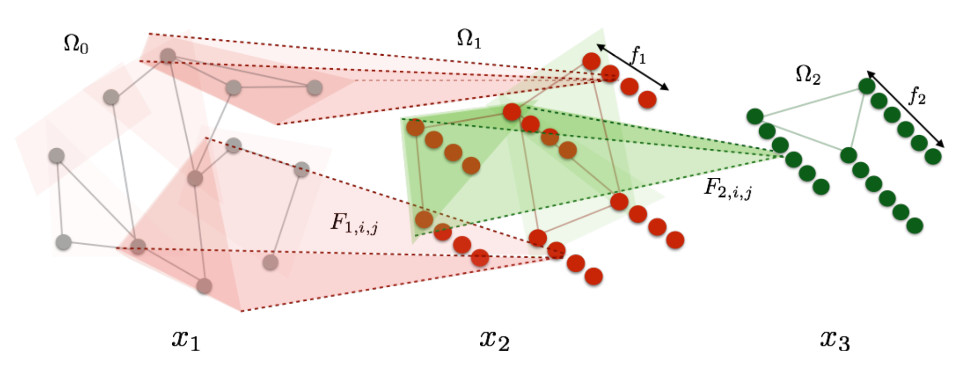
Deep locally connected network
Local
No translation
Fix graph

Slide 33
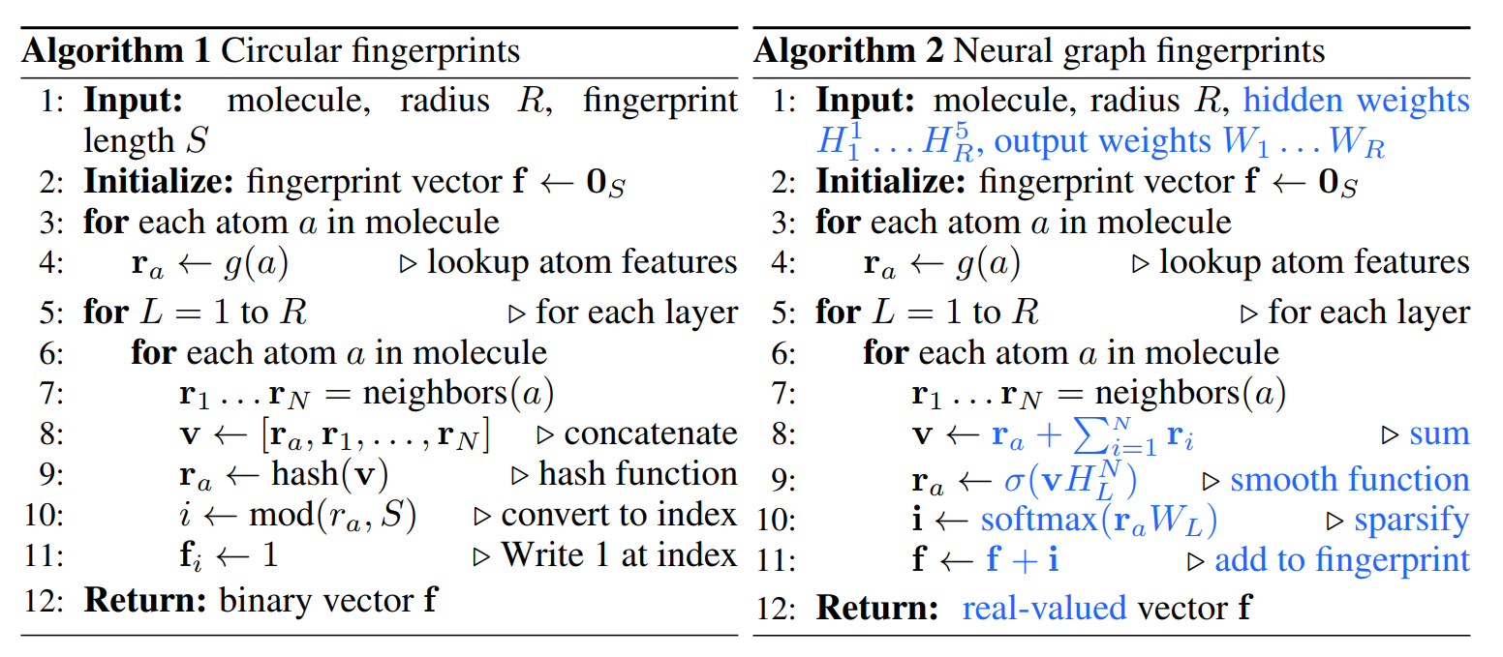
Conv example - 1
1-hop neighbors
sum
NIPS 2015, Convolutional Networks on Graphs for Learning Molecular Fingerprints

Slide 34
PATCHY-SAN
Use optimal graph normalization to partition neighborhoods.
Fixed number of receptive field.
ICML 2016, Learning Convolutional Neural Networks for Graphs

Slide 35
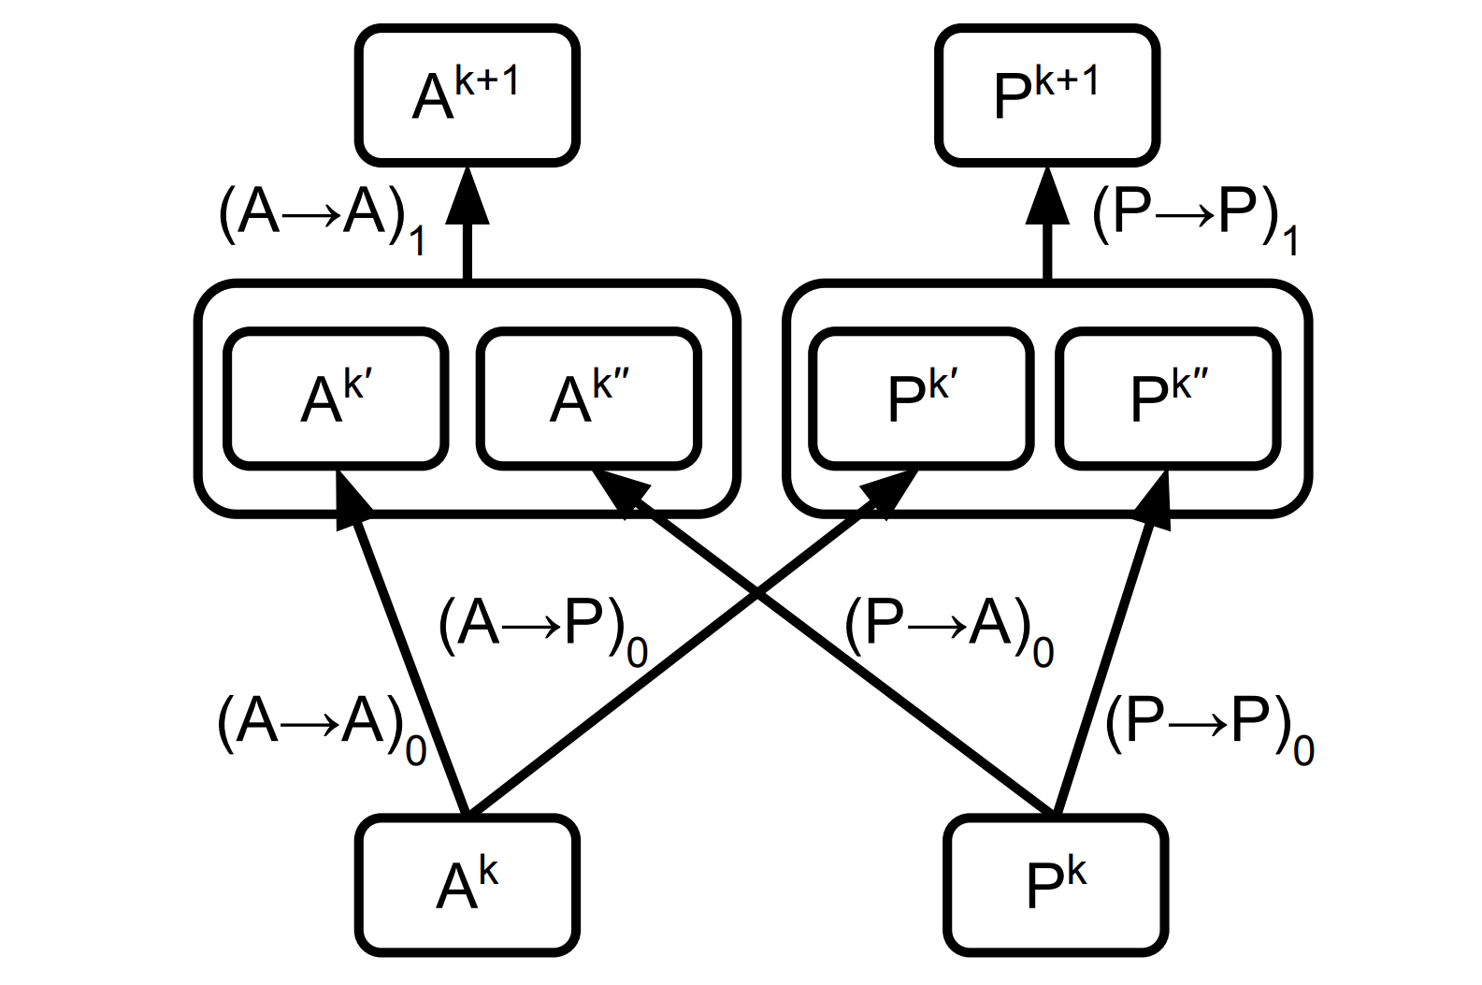
Weave module
$A→A$
$A_{a}^{k+1}=f\left(A_{a}^{k}\right)$
$P→P$
$P_{a,b}^{k+1}=f\left(P_{a,b}^{k}\right)$
$P→A$
$A_{a}^{k+1}=g\left(f\left(P_{a,b}^{k}\right), f\left(P_{a,c}^{k}\right),f\left(P_{a,d}^{k}\right),…\right)$
$A→P$
$P_{a,b}^{k+1}=g\left(f\left(A_{a}^{k},A_{b}^{k}\right),f\left(A_{b}^{k},A_{a}^{k}\right)\right)$
CAMD 2016, Molecular graph convolutions moving beyond fingerprints

Slide 36
MoNet
For a point $y∈𝒩\left(x\right)$ in the neighborhood of $x$, associate a pseudo-coordinates $u(x,y)$.
Define a weighting function (kernel) $w_{θ}\left(u\right)=\left(w_{1}\left(u\right),…,w_{J}\left(u\right)\right)$ parametrized by learnable parameters $θ$.
$$\left(f∗g\right)\left(x\right)=\sum_{j=1}^{J}{g_{j}\sum_{y∈𝒩\left(x\right)}{w_{j}\left(u\left(x,y\right)\right)f\left(y\right)}}=\sum_{y∈𝒩\left(x\right)}{\left(\sum_{j=1}^{J}{g_{j}w_{j}\left(u\left(x,y\right)\right)}\right)}$$
CVPR 2017, Geometric deep learning on graphs and manifolds using mixture model CNNs

Slide 37
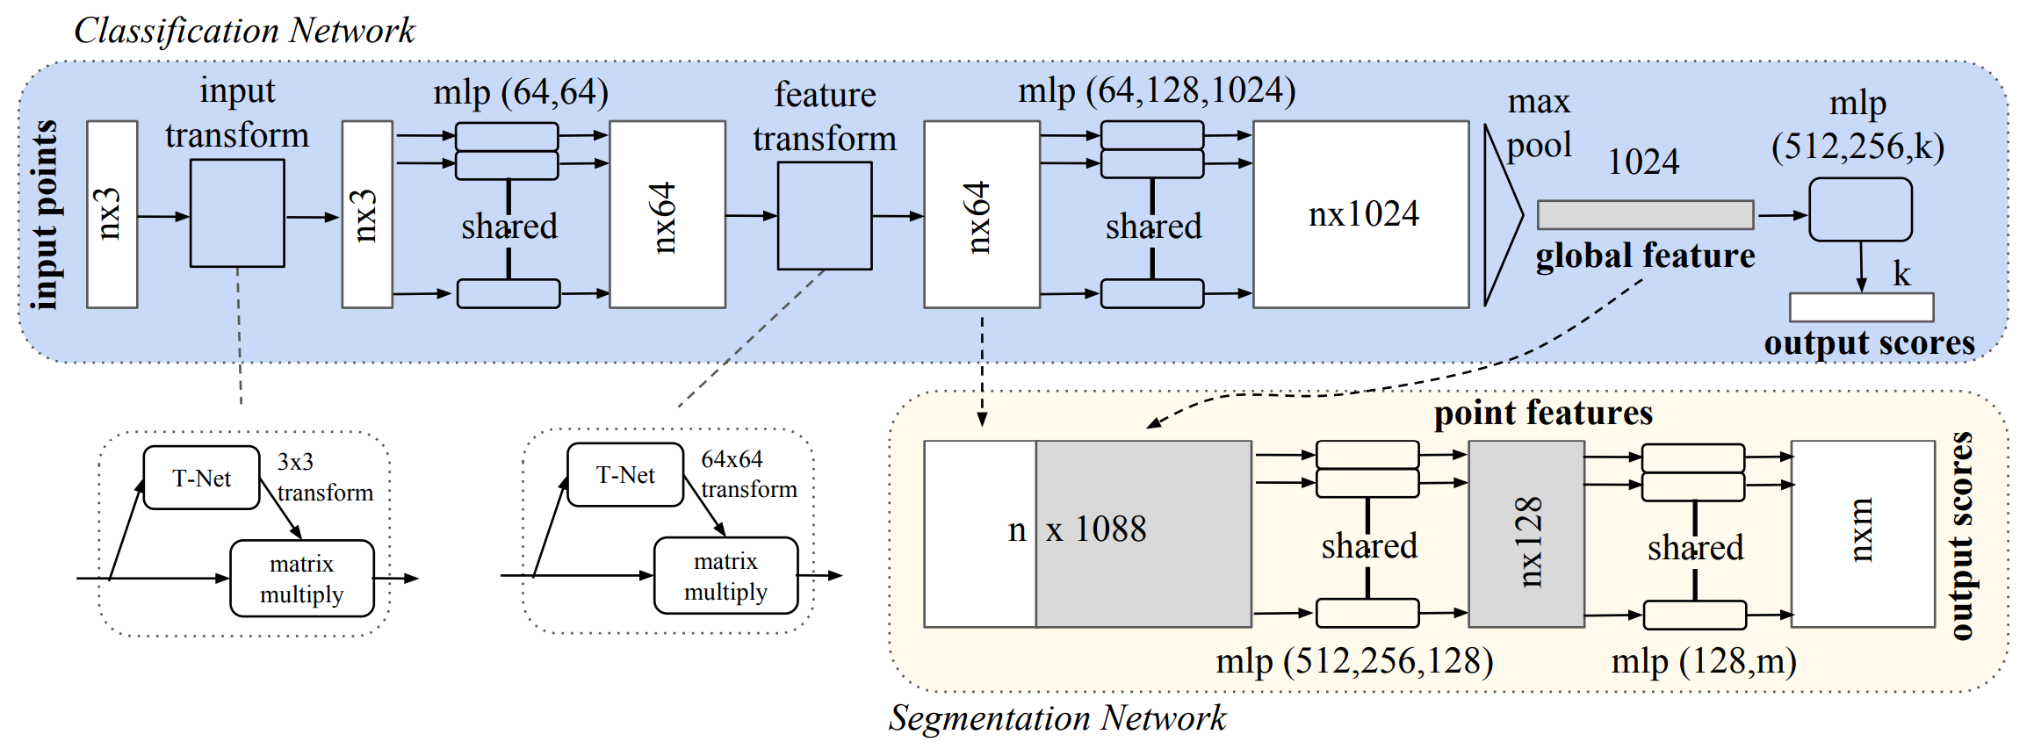
Point-net (no graph)
Use spatial transformer network to do pre-processing
Did not use graph structure
CVPR 2017, PointNet Deep Learning on Point Sets for 3D Classification and Segmentation

Slide 38
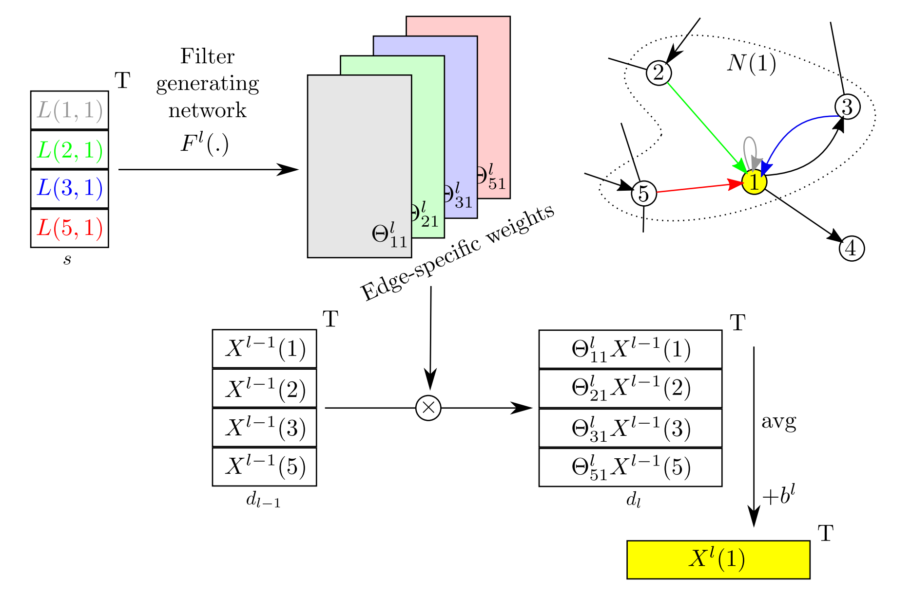
Dynamic Edge-Conditioned Filters
Filter weights are conditioned on edge labels
CVPR 2017, Dynamic Edge-Conditioned Filters in Convolutional Neural Networks on Graphs

Slide 39
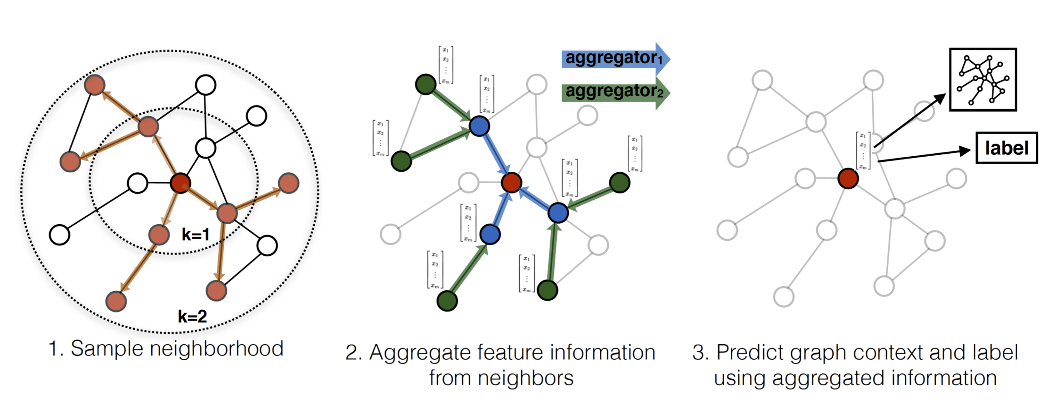
Graph-SAGE
Motivated by graph embedding
Sample a fixed-size neighbors, deal with 1-hop neighbors at each layer
NIPS 2017, Inductive Representation Learning on Large Graphs

Slide 40
With edges
1-hop neighbors
Consider both vertex and edge weights
To differentiate between neighbors, incorporate features on the edges
$$z_{i}=σ\left(W^{C}x_{i}+\frac{1}{|𝒩\left(i\right)|}\sum_{j∈𝒩\left(i\right)}{\left(W^{N}x_{j}+W^{E}A_{ij}\right)}+b\right)$$
NIPS 2017, Protein Interface Prediction using Graph Convolutional Networks

Slide 41
Semi
Consider limiting to 1-hop. Then the convolution is linear w.r.t. graph Laplacian. Further, assume $λ_{max}≈2$, then
$$g_{θ}∗x≈θ\left(I+D^{−\frac{1}{2}}AD^{−\frac{1}{2}}\right)x$$
Use the renormalization trick:
$$I+D^{−\frac{1}{2}}AD^{−\frac{1}{2}}→{\tilde{D}}^{−\frac{1}{2}}\tilde{A}{\tilde{D}}^{−\frac{1}{2}}$$
ICLR 2017, Semi-Supervised Classification with Graph Convolutional Networks

Slide 42
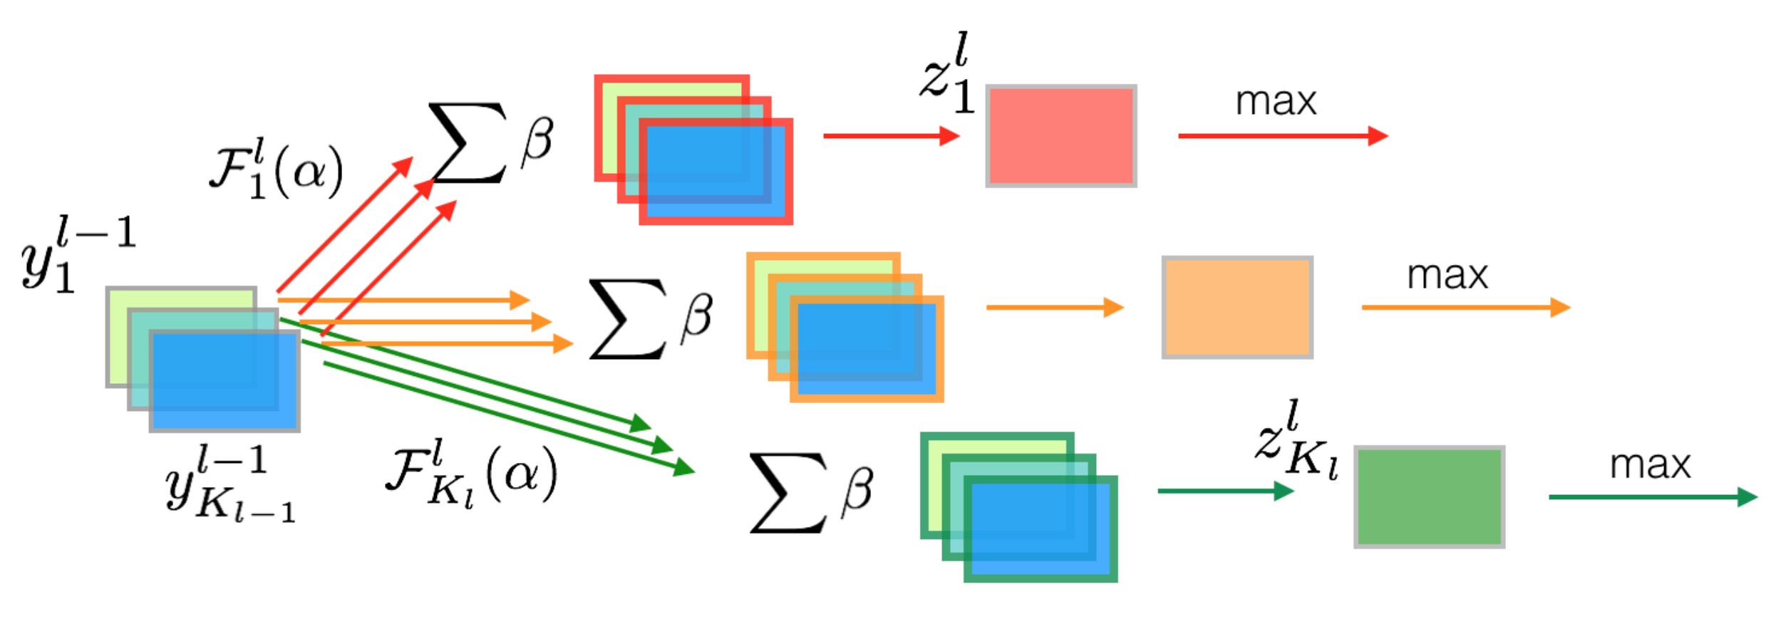
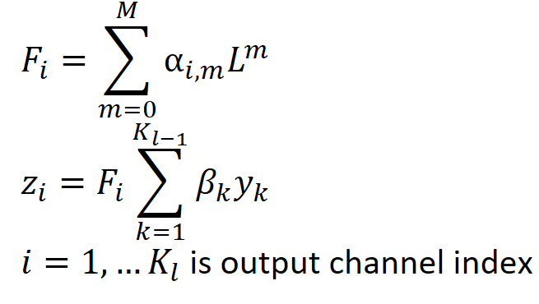
Another
First do a shared fc ($β$) along the channel to suppress signals into one channel, then use many different sets of spectral conv parameters to produce multiple output channels
ICML 2017, Graph-based Isometry Invariant Representation Learning

Slide 43
Dynamic pooling
ICML 2017, Graph-based Isometry Invariant Representation Learning

Slide 44
NLP
Different groups of weights by direction and edge labels
EMNLP 2017, Encoding Sentences with Graph Convolutional Networks for Semantic Role Labeling

Slide 45
Graph attention
1-hop neighbors
Fc for channels first
Concatenate multi-head attention results
ICLR 2018, Graph Attention Networks

Slide 46
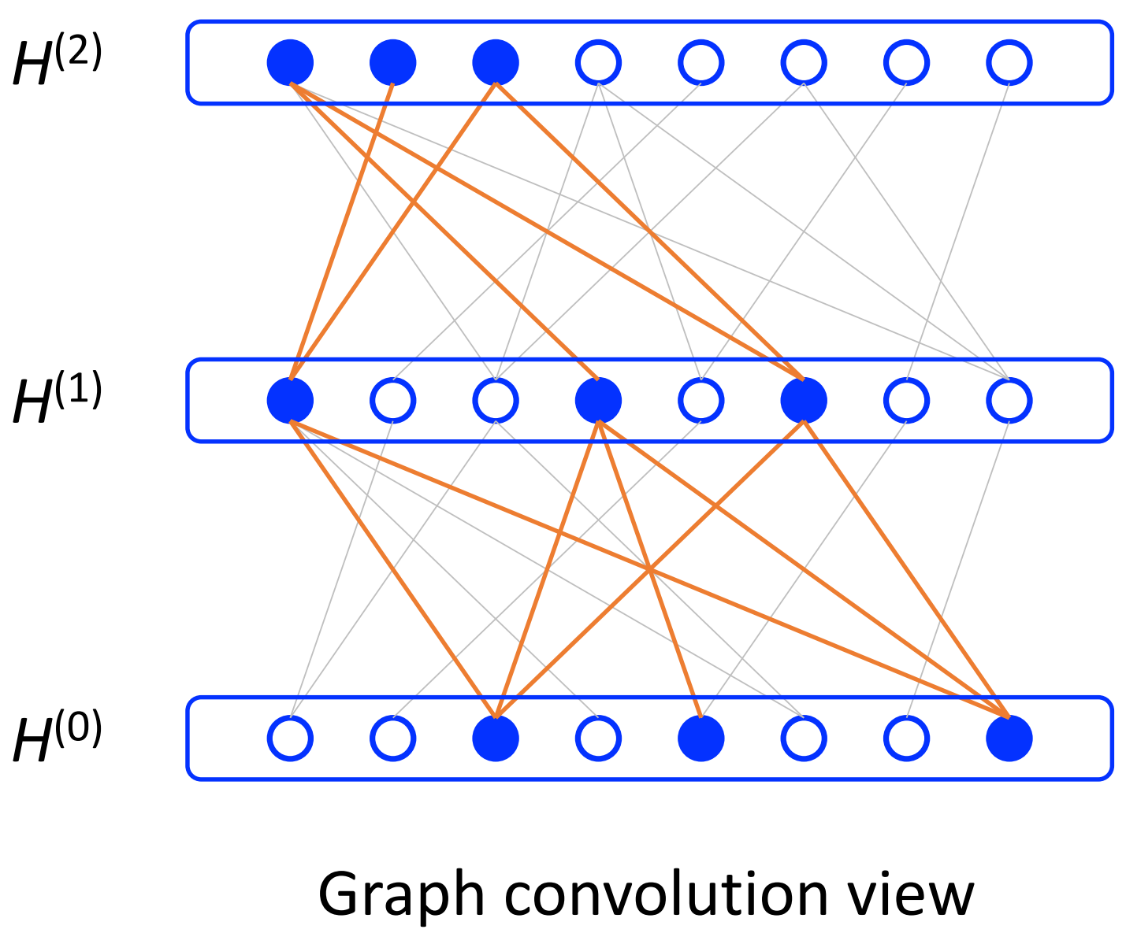
Fast-Gcn
Importance sampling a subset of nodes at each layer.
ICLR 2018, FastGCN Fast Learning with Graph Convolutional Networks via Importance Sampling

Slide 47
FeaStNet
CVPR 2018, FeaStNet Feature-Steered Graph Convolutions for 3D Shape Analysis

Slide 48
ST-GCN
Partition neighbors
AAAI 2018, Spatial Temporal Graph Convolutional Networks (ST-GCN) for Skeleton-Based Action Recognition

Slide 49
Spatio-Temporal Graph Convolution
Construct $k$-neighbor receptive field by a $k$-order polynomial of $A$ or $L$.
AAAI 2018, Spatio-Temporal Graph Convolution for Skeleton Based Action Recognition

Slide 50
Adaptive
Fc on channel
Parametrize Laplacian in a residual fashion and learn the $L_{res}$
AAAI 2018, Adaptive Graph Convolutional Neural Networks

Slide 51
Argument-aware
Directed dependent parse tree
Partition neighbors according to direction and learn weights for edges
AAAI 2018, Graph Convolutional Networks with Argument-Aware Pooling for Event Detection

Slide 52
WL
Concat multiple conv as output
Connect it to Weisfeiler-Lehman subtree kernel as continuous color
Sort and pool
AAAI 2018, An End-to-End Deep Learning Architecture for Graph Classification

Slide 53
Learnable graph conv layer
Transform graphs to enable traditional conv
Selects a fixed number of neighboring nodes based on value ranking to transform graph into 1-D format, thereby enabling regular convolution
KDD 2018, Large-Scale Learnable Graph Convolutional Networks

Slide 54
Gaan
Use a small convolutional subnetwork to compute a soft gate at each attention head to control its importance.
UAI 2018, GaAN Gated Attention Networks for Learning on Large and Spatiotemporal Graphs

Slide 55
Relational data
ESWC 2018, Modeling Relational Data with Graph Convolutional Networks

Slide 56
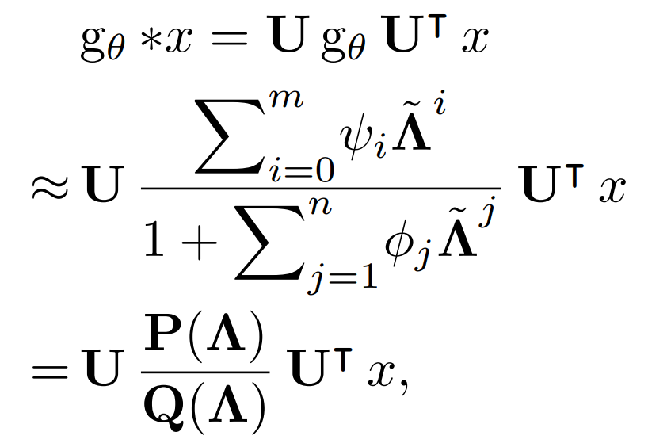
rational
Approximates spectral filter by rational function, i.e., Padé approximator
ICDM 2018, Rational Neural Networks for Approximating Jump Discontinuities of Graph Conv Operator

Slide 57
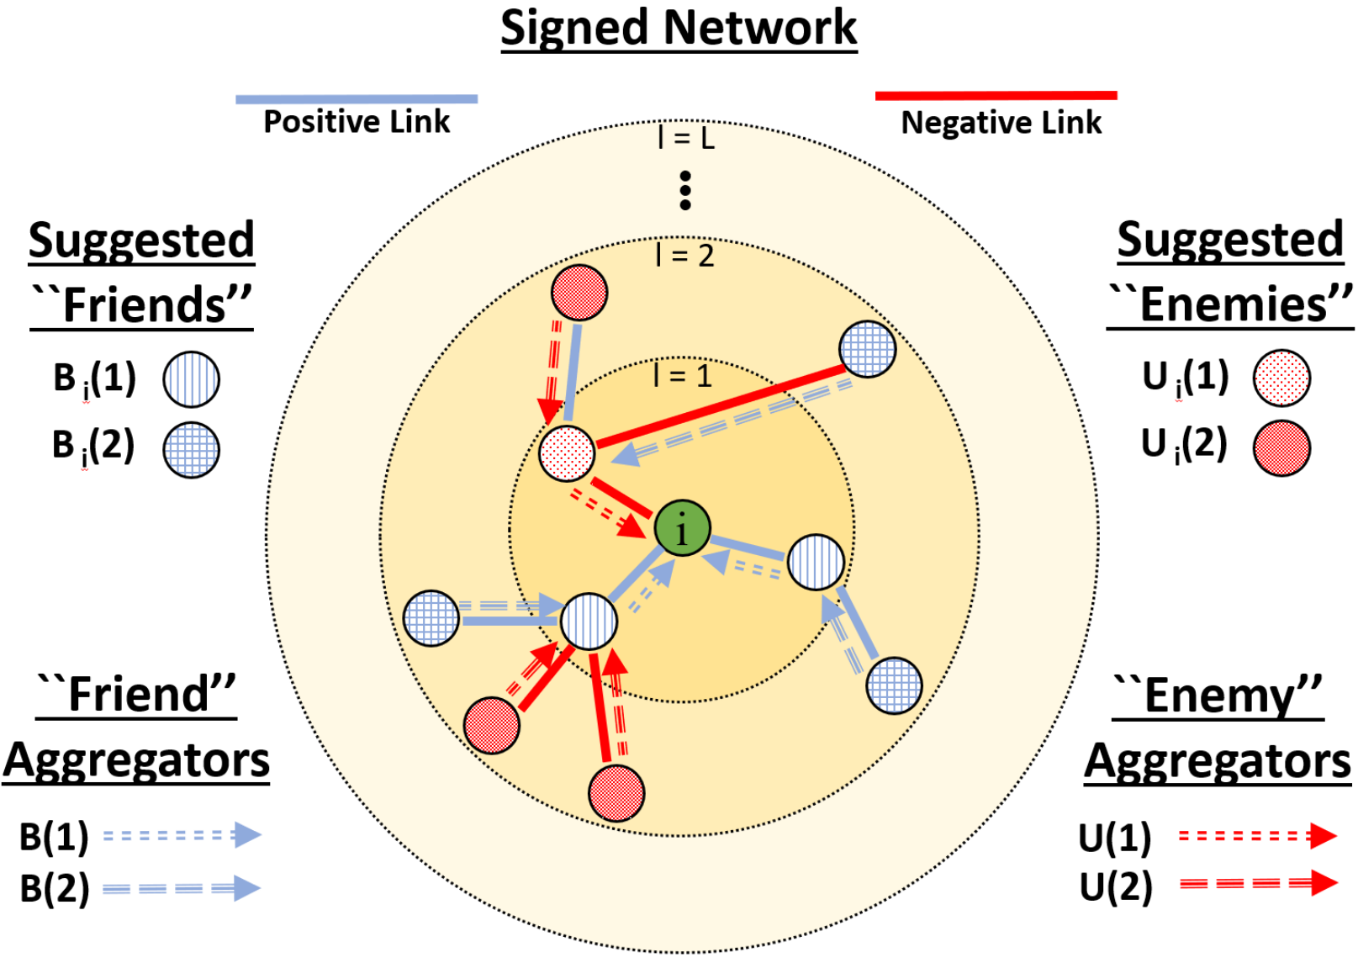
signed
Positive and negative links
ICDM 2018, Signed Graph Convolutional Network

Slide 58
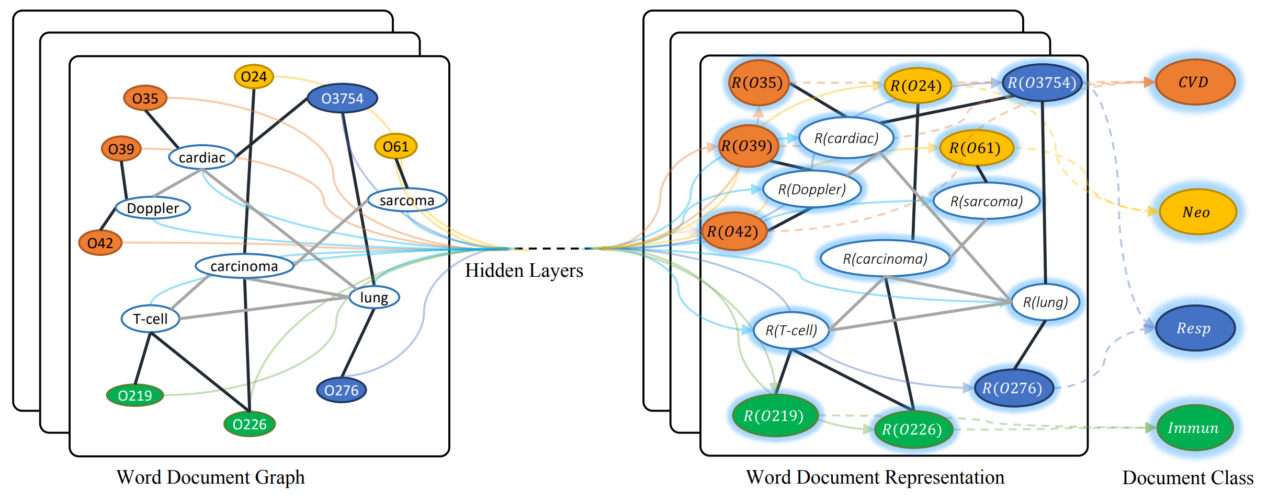
Text classification
AAAI 2019, Graph Convolutional Networks for Text Classification

Slide 59
Logic Attention
Use logic rules to measure neighboring relations' usefulness
Also use attention
AAAI 2019, Logic Attention Based Neighborhood Aggregation for Inductive Knowledge Graph Embedding

Slide 60
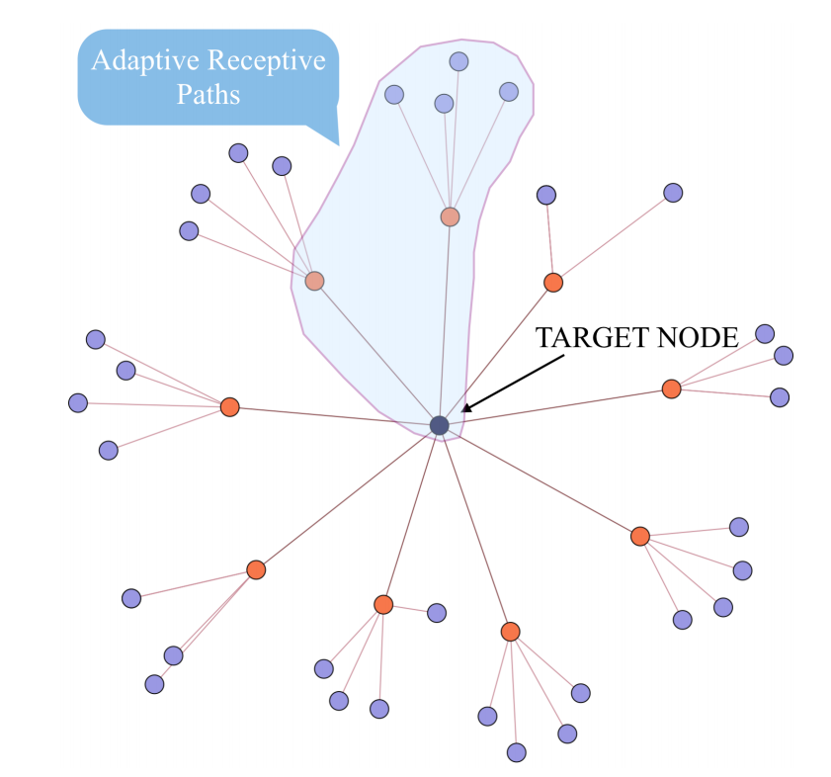
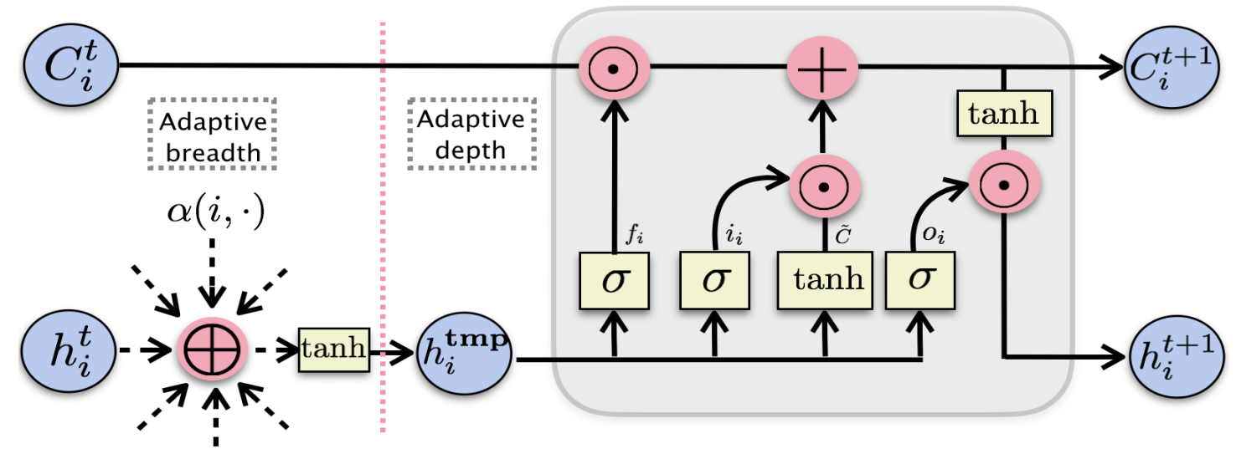
Genie-Path
AAAI 2019, GeniePath Graph Neural Networks with Adaptive Receptive Paths

Slide 61
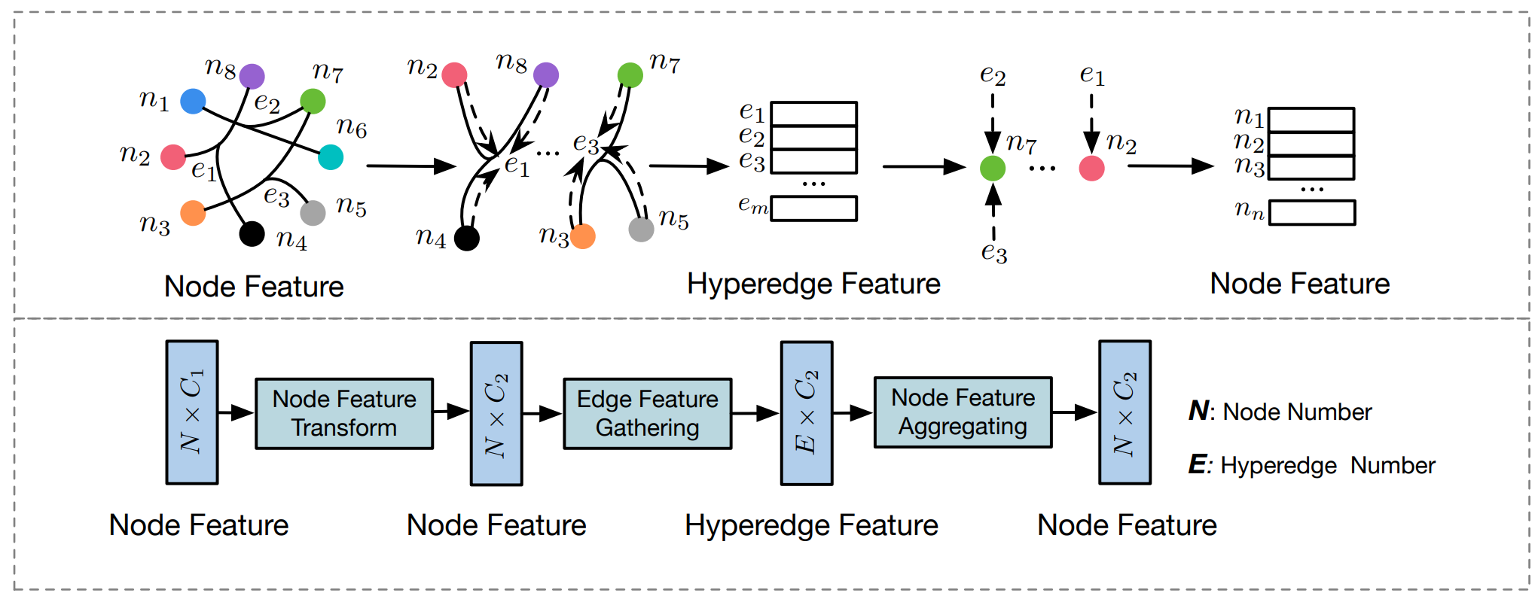
Hyper-graph
AAAI 2019, Hypergraph Neural Networks

Slide 62
Hyper-GCN
AAAI 2019, HyperGCN Hypergraph Convolutional Networks for Semi-Supervised Classification

